Slide 2
Our Vision:
To excel in providing export credit insurance and trade related services.
Our Mission:
To support the Indian Export Industry by providing cost effective insurance and trade related services to meet the growing needs of Indian export market by optimal utilization of available resources.

Slide 3
Background
Export Credit Agency - ECGC, A systemically important institution
Under Ministry of Commerce – supports around 30% of exports
Composition - Board of Directors ; Company’s Act
Regulated by IRDAI; Oversight by DPE & CAG
Network of offices – 5 Regional Offices, 60 Branches, HO-Mumbai
iAAA rating by ICRA, Jamnalal Bajaj Uchit Vyavahar Puraskar 2018

Slide 4
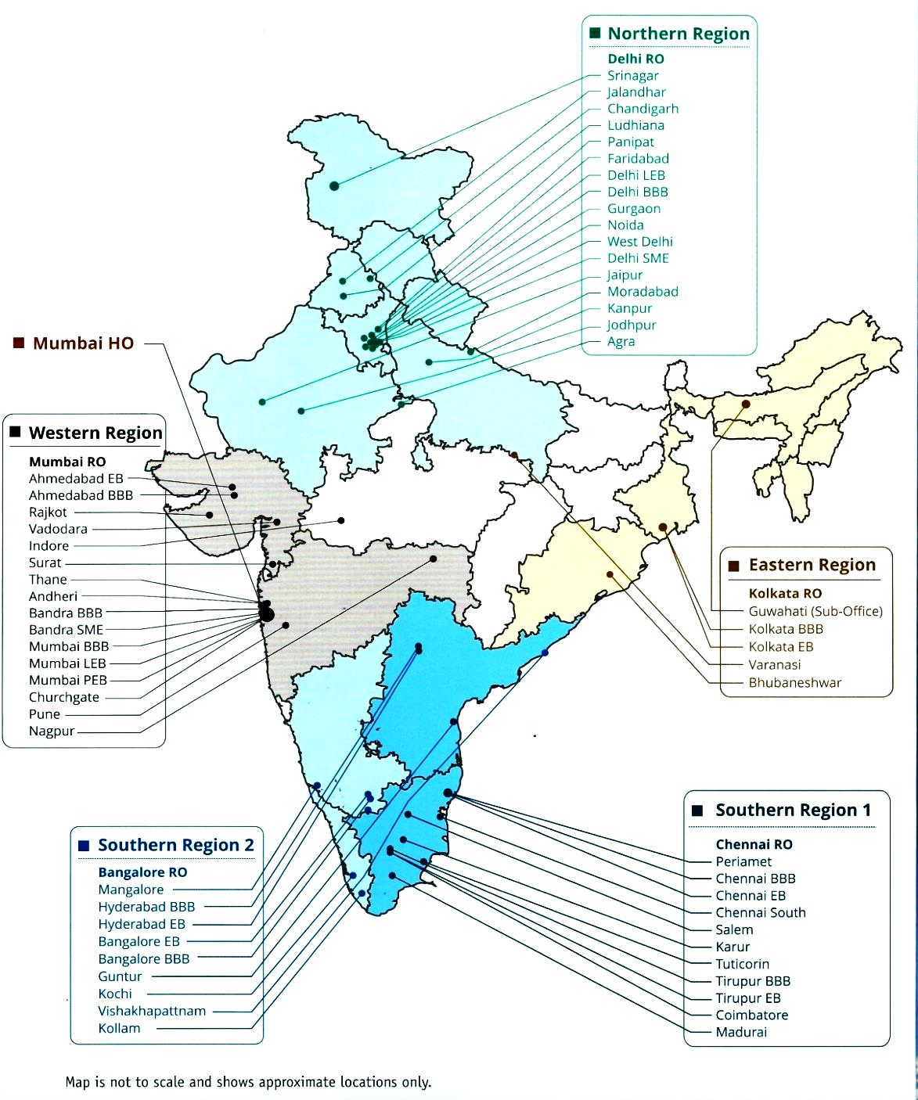
Service Network
Northern Region states Delhi
Chandigarh
Haryana
Himachal Pradesh
Jammu and Kashmir
Jharkhand
Madhya Pradesh (part)
Punjab
Rajasthan
Uttar Pradesh (West)
Uttarakhand
Western Region states Maharashtra
Dadra and Nagar Haveli
Daman and Diu
Goa
Gujarat
Madhya Pradesh (part)
Eastern Region states West Bengal
Bihar
Chhattisgarh
Odisha
Seven NE states
Sikkim
Uttar Pradesh (East)
Southern Region-2 states Karnataka
Andhra Pradesh
Kerala
Lakshadweep
Telangana
Southern Region-1 states Tamil Nadu
Andaman and Nicobar Islands
Puducherry

Slide 5
ROLE OF ECGC
ECGC
(Insurer)
Exporters
Banks/FIs
ECIB Cover
Short Term, Medium & Long Term
Short Term(ST)
Medium and Long Term (M&LT)
Fund based
Non fund Based

Slide 6
Explore and expand business in new markets
Offer liberal credit to buyers on LC and Non-LC terms of payment
Get export loans from Banks
Working capital cycle is restored on settlement of claim
Supports Banks in the event of non-payment by the borrower
Increased liquidity for banks through ECGC claims
Lower provisioning to the extent of ECGC coverage
Adequate credit to exporters
Lower margins / collateral securities
Benefits to Exporters
Benefits to Banks

Slide 7
Risks covered by ECGC
Exporters
Banks
Commercial - Buyer /Bank
Political
War, Civil war etc
Insolvency of Exporter
Default of Exporter
Protracted Default
Contract Repudiation
Insolvency
Default & Insolvency of LC opening bank
Import Restrictions
Transfer delay
Diversion of Voyage

Slide 8
Risks - Not Covered
Commercial disputes including quality dispute.
Default by an agent of exporter or of the collecting bank.
Buyer’s failure to obtain necessary import authorization.
Exchange fluctuation.
Physical damage of goods which is covered by other general insurers.
Loss due to inherent nature of goods.
Exporter’s failure to comply with the T&C of the contract/order.

Slide 9
Buyer’s Score Card Model Factors - Business ability, Financial strength, Transaction behaviour, Industry outlook
Over one lakh active Buyers on record on whom Overall limit is fixed
Buyer Specific Approval List
Country Risk Model Factors - Economic, Political, Experience of ECGC and others Berne Union members, Bilateral relations, Forecast
No. of Countries covered- 249 (A1, A2, B1, B2, C1, C2 & D)
Countries are classified in Open Cover and Restricted Cover
Buyer Underwriting
Country Underwriting

Slide 10
LOSS MINIMIZATION MEASURES
LESS- PAYMENT
NO-PAYMENT
DELAYED PAYMENT
TEMPORARY FINANCIAL
CRISIS
DISCOUNT
INSOLVENCY
REPUDIATION
DEFAULT
CONVERSION
EXTENSION
RE-SALE
RE-IMPORT
ABANDONED

Slide 11
To Cover all Transactions
To encourage Small Exporters
ST Covers
for
Exporters
(Policy)
Shipments Comp. Risks Policy
Specific Shipment Policy
Exports (specific buyer) Policy
Buyer Exposure Policy
Customer Specific Policy
Export Turnover Policy
Multi buyer exposure Policy
Services, ITES, Software Project Policy
Consignment Policy
(CGE & CSA)
Export Factoring
Small Exporters Policy & Micro Exporters Policy
For Large Exporters
For MSMEs
To cover Consignment exports
To cover Specific Transactions
To cover Services
To cover Specific Buyer
Tailor made cover

Slide 12
Pricing under Policy
Type of Policy cover – Declaration or Exposure
Whole Turnover or Individual or Specific Cover
Country of Buyer/Country of Destination.
Terms of Payment viz DP/DA/LC
Discounts / Malus

Slide 13
TYPES OF ECIB COVERS
FOR BANKS
FUND BASED
NON-FUND BASED
PACKING CREDIT
POST SHIPMENT
SURETY COVERS
WHOLE TURNOVER AND INDIVIDUAL COVERS
WHOLE TURNOVER AND INDIVIDUAL COVERS
WTPC, INPC, BIPC
WTPS, INPS

Slide 14
Financial Performance
(Rs in cr)
Particulars | 2014-15 | 2015-16 | 2016-17 | 2017-18 | 2018-19 | 2019-20
Premium Income | 1362 | 1321 | 1268 | 1240 | 1247 | 1075
Claims Paid | 590 | 1123 | 885 | 1283 | 1013 | 408
Recoveries | 160 | 114 | 131 | 186 | 151 | 166
Profit Before Tax | 255 | 387 | 407 | 130 | 314 | 400
Income Tax | 75 | 111 | 125 | 55.5 | 84 | 87
Dividend & Dividend Distribution Tax | 58 | 78 | 87 | 18.08 | 72.33 | 0
Total Returns to GOI | 133 | 189 | 212 | 73.58 | 156.33 | 87
Net Worth | 2989 | 3279 | 3619 | 3737 | 4463 | 5214
Paid Up Capital | 1200 | 1300 | 1450 | 1500 | 2000 | 2500
Investment Assets | 6718 | 7185 | 8025 | 8486 | 10345 | 12242

Slide 15
Council for Fair Business Practices (CFBP) recognised and applauded ECGC with an award under Services Sector for practising, promoting and committing to fair business practises
Empowering India’s Exports
www.ecgc.in

